Slide 1

TELCO CUSTOMERS ANALYSIS

Slide 2
AGENDA
1
2
3
Data Sources
Data Gathering
Data Preprocessing
4
5
6
Data Integration
Analysis & Cubes
Paginated Reports
7
8
Dashboards
Recommendations

Slide 3
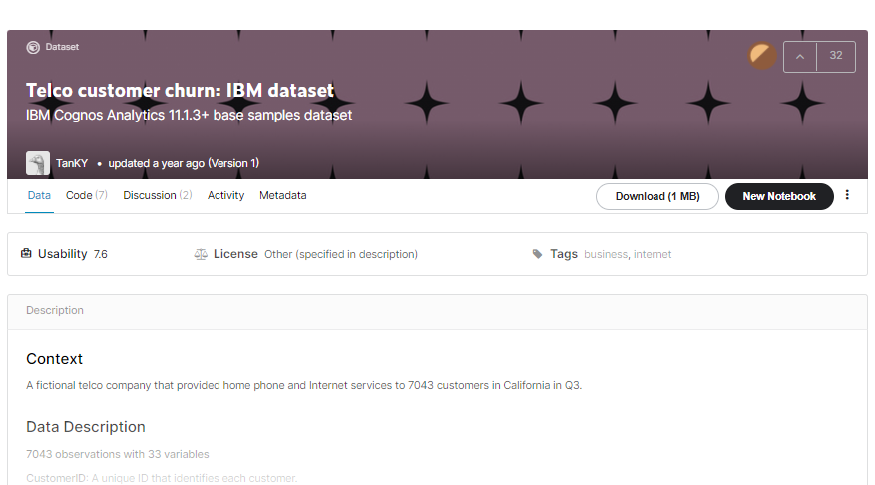

DATA SOURCES
Telco Customer Churn: IBM Dataset
A Fictional Telco Company That Provided Home Phone And Internet Services To 7043 Customers In California.
- 7043 Rows with 33 Columns
- Telco customer churn , It contains 5 tables:
Customer
Location
Population
Services
Status

Slide 4


DATA GATHERING
We wanted to expand our data to get more information and get more dimensions and realistic insights
New data sources :
Data of company employees (excel)
Data of company branches (excel)
Building customers schedule table (SQL DB)
- Join date to our company
- leaving date if he churned our company
Gathering all data excel sheets and kaggle dataset
Into one database (SQL server DB)

Slide 5
“Deleting Unwanted Columns” “Identifying And Handling The Missing Values”
DATA PRE-PROCESSING

Slide 6
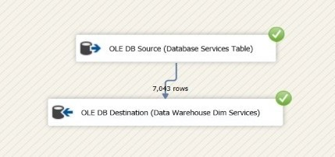
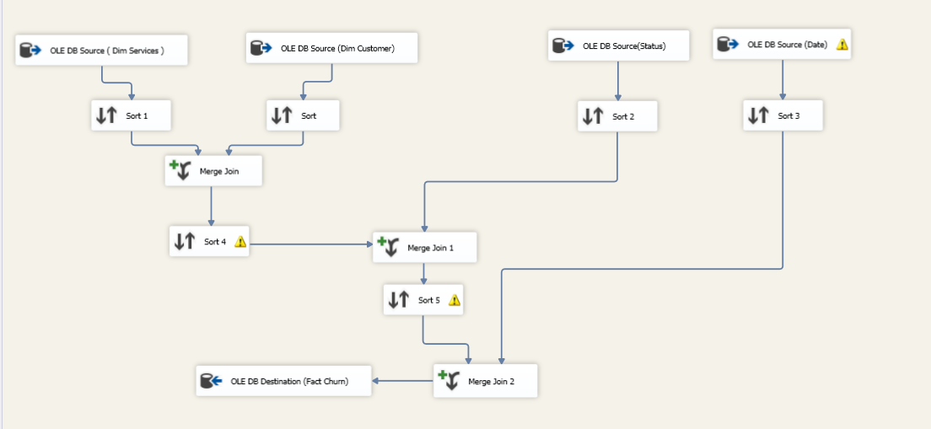
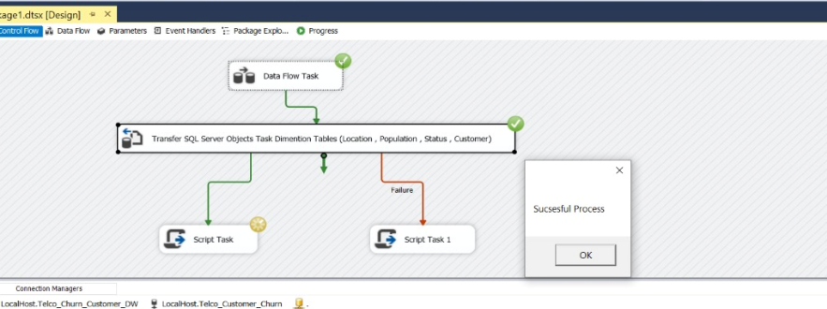
DATA INTEGRATION
Build data warehouse structure
- Fact table [fact churn]
- Dimensions tables
Integrate database to the data warehouse
With SQL server integration tool (SSIS)

Slide 7
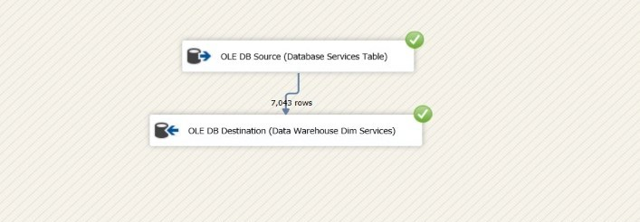
Integrate Part Of Services Table Into Data Warehouse

Slide 8
Integrate Dimension Tables Into Data Warehouse

Slide 9
Integrate Fact Table Into Data Warehouse

Slide 10
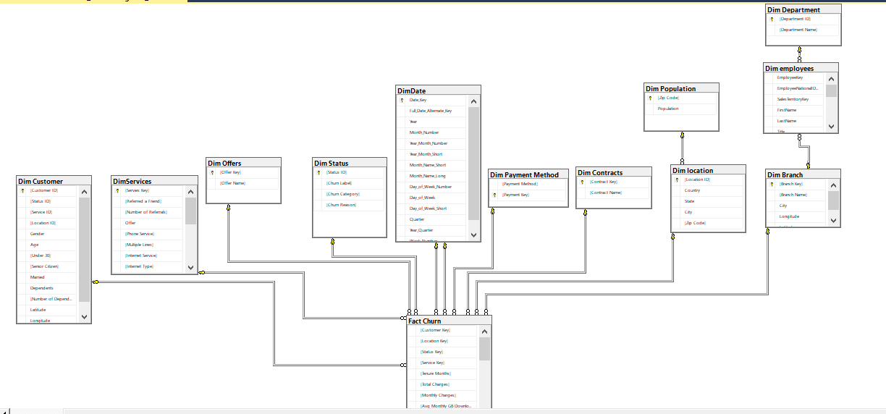
Final Data Warehouse (Snowflake Schema)

Slide 11
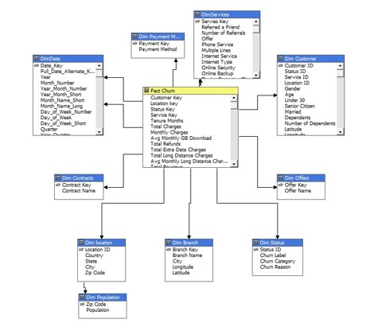
ANALYSIS & CUBES
Build Data Warehouse Cube
with SQL Server Analysis Tool (SSAS)

Slide 12
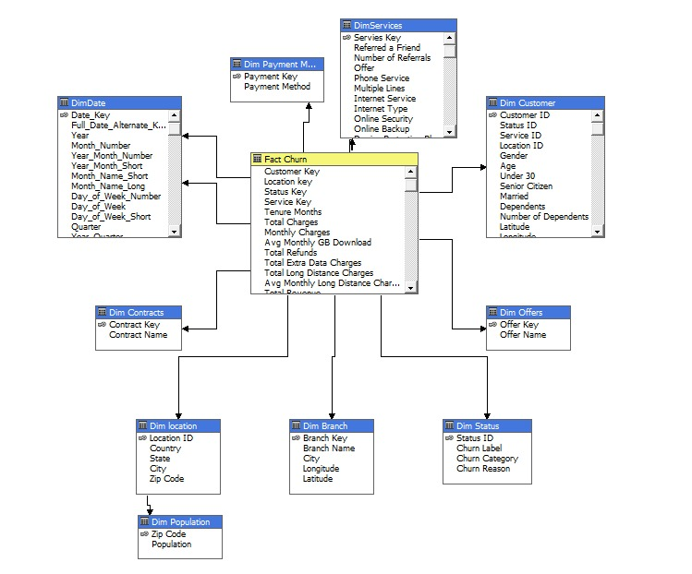
Data Cube

Slide 13

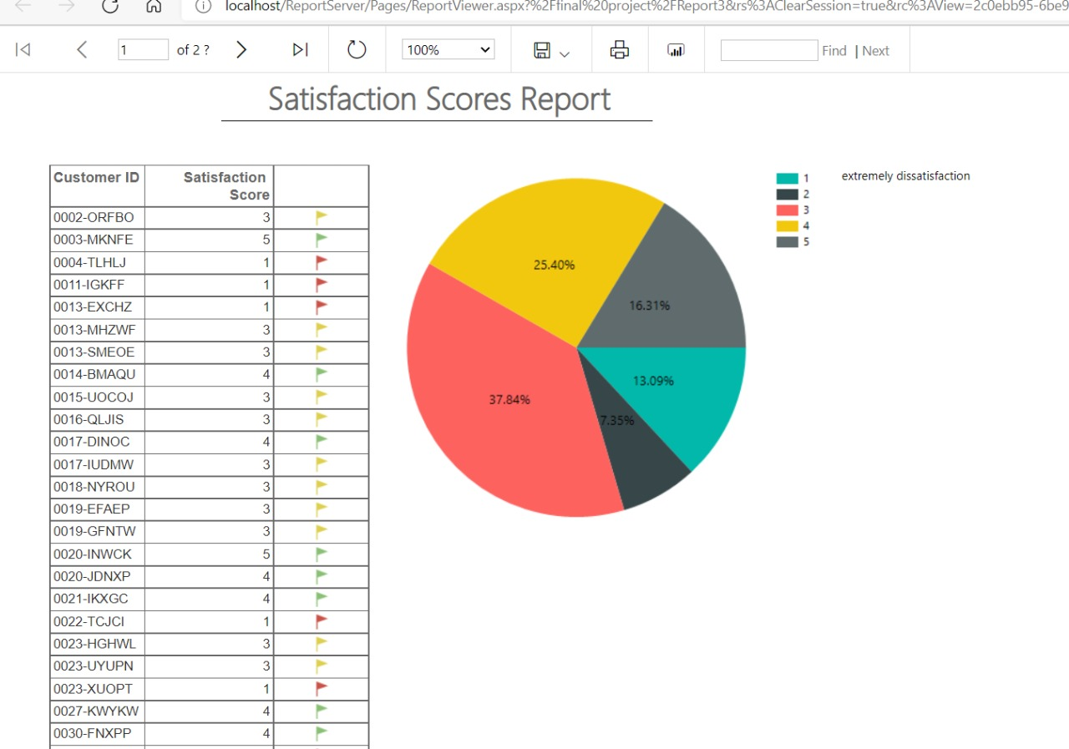
PAGINATED REPORTS

Slide 14

DASHBOARD

Slide 15
RECOMMENDATIONS
Reconsider the contract type “month to month” and offering attractive yearly family packages
Enhance streaming services
Enhance fiber optic internet service
Avoid making the offer E again
More marketing campaigns and attractions for offers
Reconsider the unlimited data
Enhance our devices
Hold training courses for support persons and taking care of the psychological aspect of them while encouraging them if they get A high evaluation every month
Prioritize the high-income age group to keep them

Slide 16
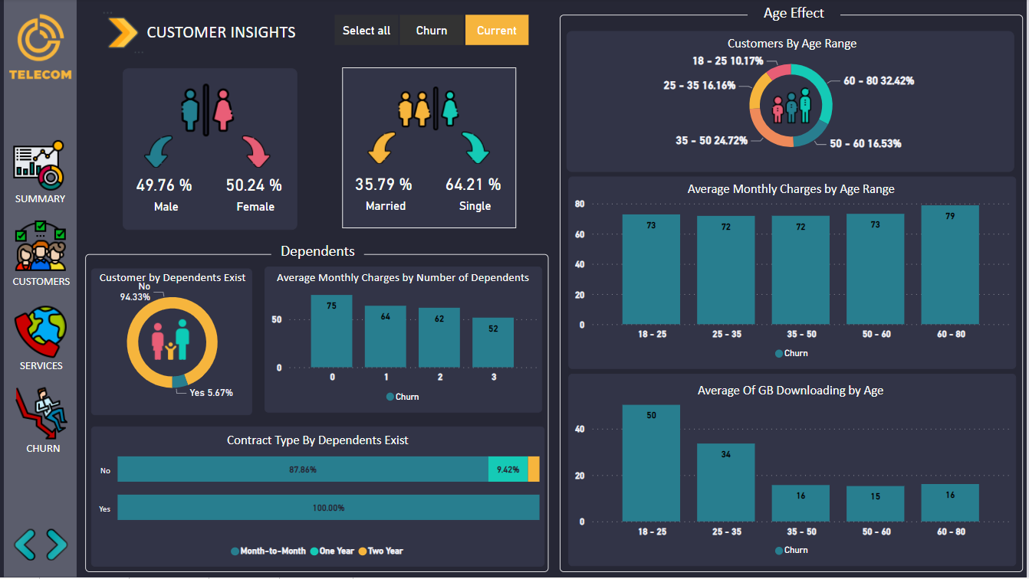

Slide 17
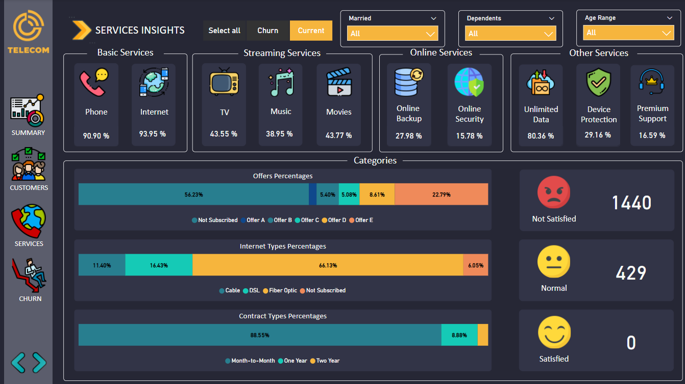
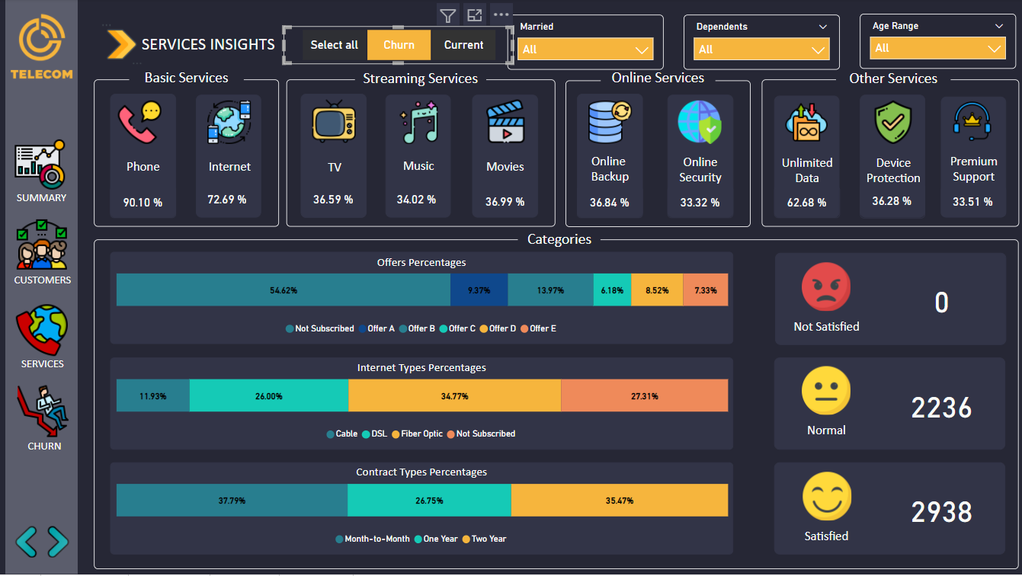

Slide 19
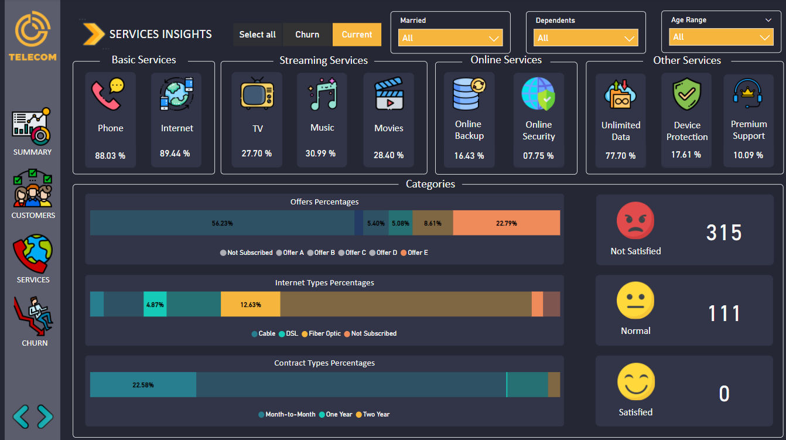

Slide 20
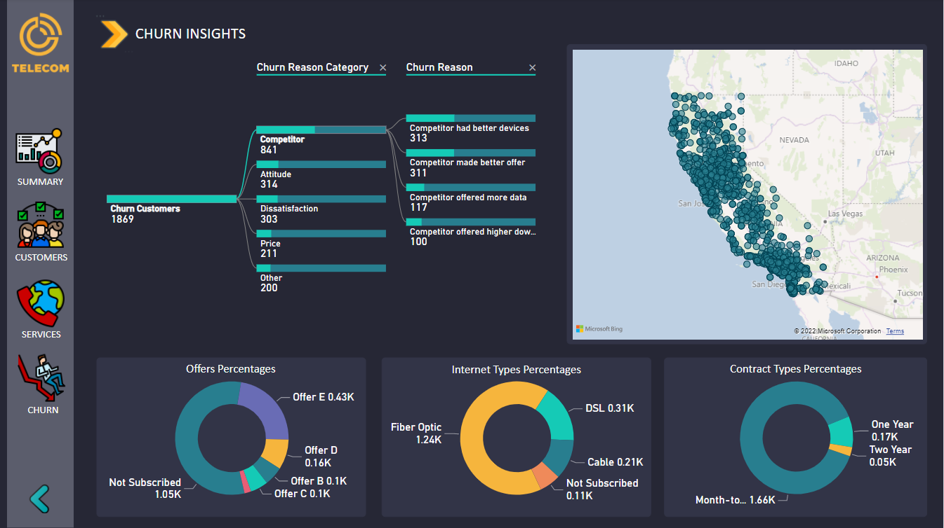

Slide 21
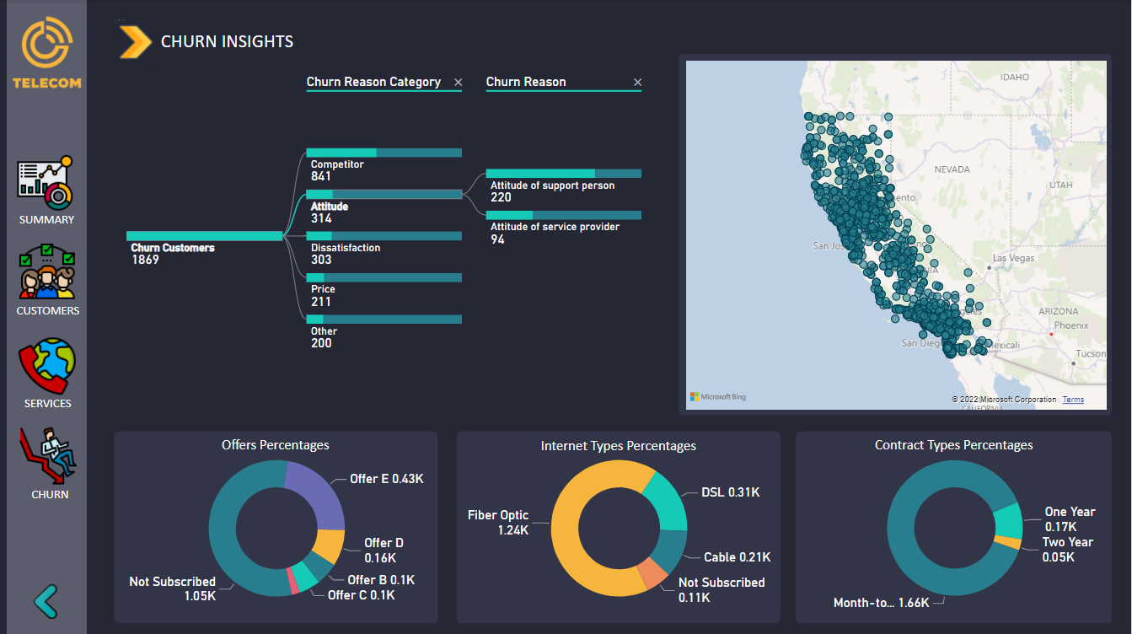

Slide 22
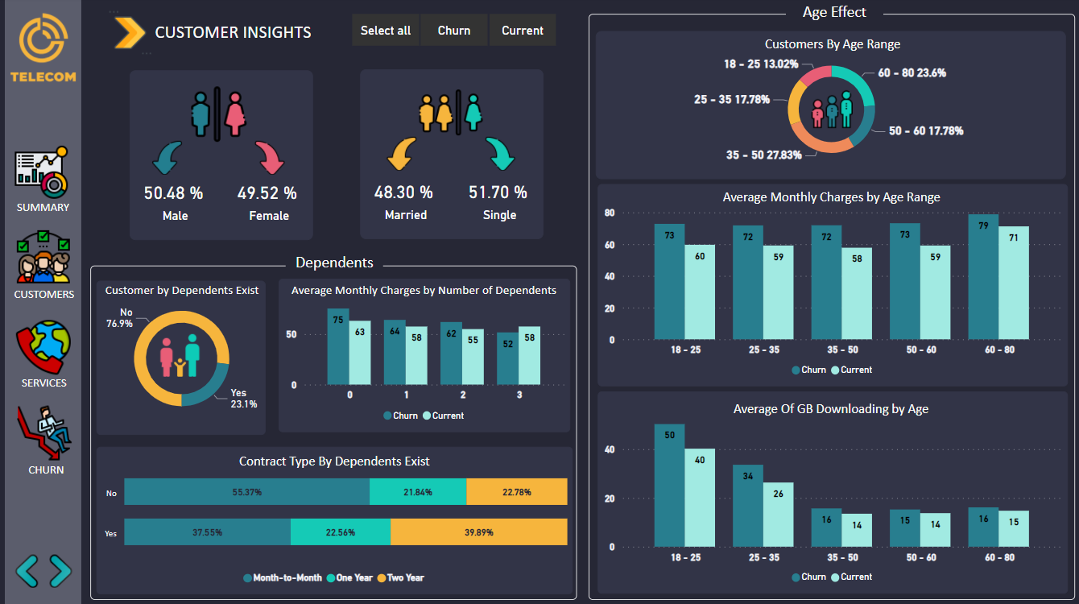

Slide 23
THANKS

